Slide 1

ROAD ACCIDENT PREDICTION
TEAM MEMBERS
S.SAIVARNIKA (20NM5A0517)
S.YAMUNA (20NM5A0516)
R.BHAGYA SRI (20NM5A0515) P.JOSHNA (20NM5A0513)
G.ALEKHYA (20NM5A0504)

Slide 2
CONTENTS
ABSTRACT
INTRODUCTION
EXISTING SYSTEM
PROPOSED SYSTEM AND METHODOLOGY
REQUIREMENTS
ABOUT MACHINE LEARNING
MAIN OBJECTIVE OF PROJECT
RESULT
CONCLUSION

Slide 3
ABSTRACT
Today, traffic safety is one of the main priorities of governments. There are several safety measures are build for automobiles but traffic accidents are unavoidable. Identifying the cause of road accidents as become the main aim to reduce the damage caused by traffic accidents. In this study we find factors behind road traffic accidents using Machine learning algorithms. Patterns involved with different circumstances can be detected by developing an accurate prediction models which will be capable of automatic separation of various accidental scenarios. These classification techniques will be useful to prevent accidents and develop safety measures.

Slide 4
INTRODUCTION
There is a huge impact on the society due to traffic accidents where there is a great costs of fatalities and injuries
The data mining techniques are used to identify the locations where high frequency accidents are occurred, classification technology based on gender classification, identifying high-density accident hotspots
the severity of damage occurring during a traffic accident is replicated using the performance of various machine learning paradigms, such as neural networks, support vector machines, decision trees.

Slide 5
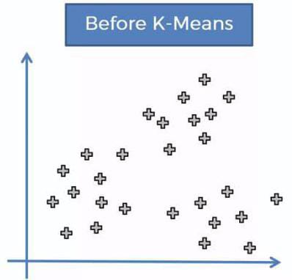
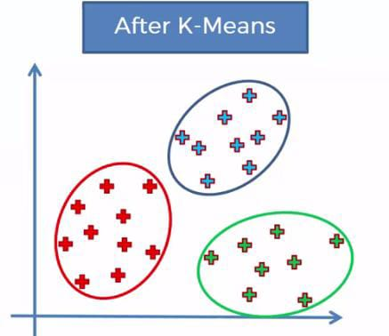
EXISTING SYSTEM
Data Mining techniques are used to identify the locations where high frequency accidents are occurred and analyze them to identify the factors that have an effect on road accidents at that locations. The first task is to divide the accident location into k groups using the k-means clustering algorithm based on road accident frequency counts. Then, association rule mining algorithm applied in order to find out the relationship between distinct attributes which are in accident data set and according to that know the characteristics of locations.

Slide 6
PROPOSED SYSTEM AND METHODOLOGY
Models are created using accident data records which can help to understand the characteristics of many features like drivers behaviour, roadway conditions, light condition, weather conditions and so on. This can help the users to compute the safety measures which is useful to avoid accidents.
It can be illustrated how statistical method based on directed graphs, by comparing two scenarios based on out-of-sample forecasts. the model is performed to identify statistically significant factors which can be able to predict the probabilities of crashes and injury that can be used to perform a risk factor and reduce it.

Slide 7
REQUIREMENTS
Hardware Requirements
Operating System- Windows 10
Processor-I3
Hard Disk-500GB
RAM 4GB
Software Requirements
Front End - HTML, CSS, JAVA SCRIPT
Programming Language – PYTHON

Slide 8
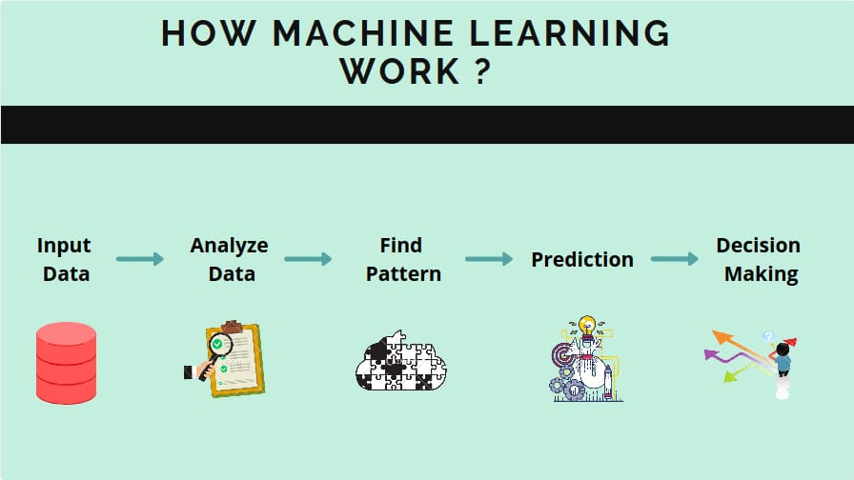
ABOUT MACHINE LEARNING
Machine learning is an application of Artificial Intelligence that provides system the ability to automatically learn and improve from experience without being explicitly programmed

Slide 9

MAIN OBJECTIVE OF PROJECT
The main purpose of our project is to analyze the data set by using machine learning algorithms The analyzed data set can be provided to the government by using this they are taking precautions before occurrence of accidents due to this we are reducing the occurrence of road accidents.

Slide 10
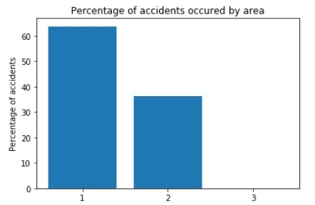
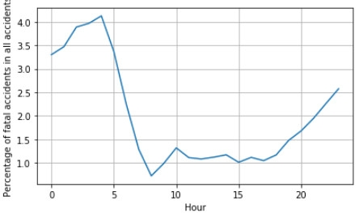
RESULT
Fraction of Accidents Occurred in Urban, Rural and Other (Na) Areas
The Most Dangerous Time To Drive

Slide 11
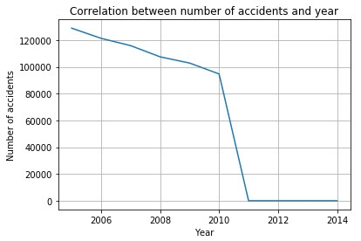
Number Of Accidents That Occur Each Year

Slide 12
CONCLUSION
Road Accidents are caused by various factors. By going through all the research papers it can be concluded that Road Accident cases are hugely affected by the factors such as types of vehicles, age of the driver, age of the vehicle, weather condition, road structure and so on. Thus we have proposed an application which gives efficient prediction of road accidents based on the above mentioned factors. Due to analyzing and severity prediction we can reduce the road accidents by taking some precautions before occurrence of accidents

Slide 13


